Slide 1
Behaviour Trees
On Good Behaviour

Slide 2
Best Of All Worlds
Combine many of the techniques we have already sen
Action execution
State machines
Decision trees
Into one simple architecture
Also include planning elements

Slide 3
What Is It
A tree of nodes
Different classes of node perform different tasks
Same as actions as seen before (will use this term from now on)
Simple and atomic
Nodes provide consistent interface
Nodes can be combined into hierarchy
Hierarchy takes form of a tree
Unlimited number of child nodes i.e. not always binary
Branches are modular
Can be reused in different places

Slide 4
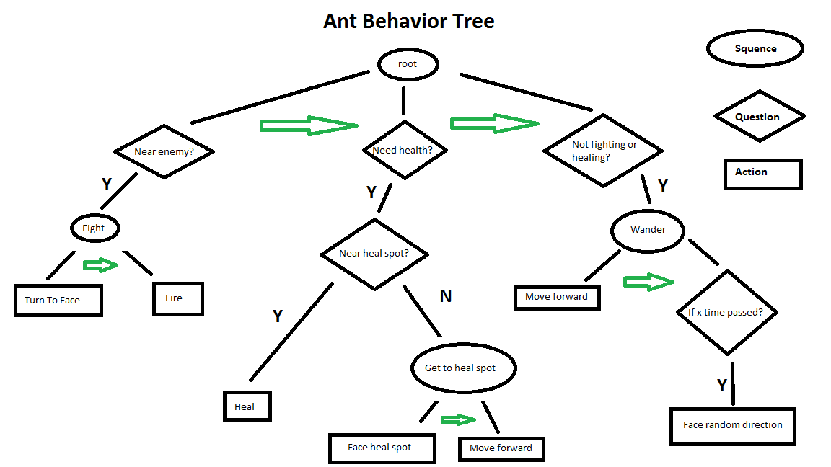
Example

Slide 5
Types Of Nodes
Three main classes of node:
Conditions
Composites
Actions
These nodes provide the following interface:
Success : The node has finished successfully
Failure : The node has been unable to complete it’s task
Running : The node is currently working, success or failure not established
This interface returns the appropriate values to the parent node

Slide 6
Conditions
Tests some condition in the game world
E.g. is an enemy within a specific distance
If the condition is true
Node returns success to parent node
If the condition is not true:
Node returns failure
Although ‘running’ is rare for a condition check
It’s not impossible
Can be a leaf node

Slide 7
Composites
Composite nodes consist of multiple child nodes
Order is important
Two main types of composite node
Sequence : Processes it’s child nodes in left to right order
Selector : Attempts all child nodes in left to right order
Must have child nodes
At least 1
2 or more to be meaningful
Sometimes also see:
Concurrent : Processes all child nodes in parallel
Random : Selects and processes a child node at random

Slide 8
Sequence Composite Node
Processes its child nodes in left to right order
Succeeds only if all child nodes succeed
If any child node fails
Entire sequence fails
Equivalent to ‘AND’
Returns success when sequence completes successfully

Slide 9
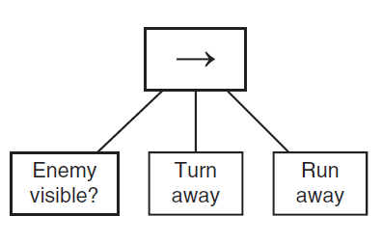
Example

Slide 10
Selector Sequence Node
Tries all its child nodes in left to right order
Succeeds if any child node succeeds
Fails if all child nodes fail
Equivalent to ‘OR’

Slide 11
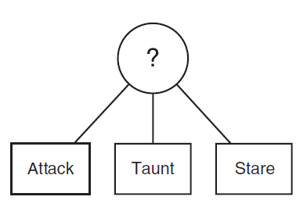
Example

Slide 12
Concurrent And Random
Concurrent
Usually succeeds if all child nodes succeed
Can be configured in other ways e.g. when one child node succeeds
Same as compound actions
Combines actions
Random
Succeeds if any child node succeeds
Adds unpredictable element to AI
Can be made to keep trying until all options fail

Slide 13
Actions
Almost identical to Actions as seen in action lists
But must maintain consistent interface with other nodes though
Success, fail, running
Simple, atomic actions
E.g. move, attack, use health kit etc.
Leaf nodes of tree
Cannot have child nodes

Slide 14
Blackboard
Nodes must have access to world state
Implemented as a blackboard
Sometimes called data context
Stores information about world
E.g. Agent location, enemy location etc.
Nodes can read and write to blackboard
For cooperative AI
Other agents can access blackboard

Slide 15
Decorators
Additional nodes can also be defined
Modify results from child nodes
Called Decorators
For example
Reverse child node results, e.g. success becomes fail, fail becomes success
Equivalent to ‘NOT’
Set timer e.g. to repeatedly trigger a sub-tree
Limit number of times a sub-tree can run
And many others (do some background reading)

Slide 16
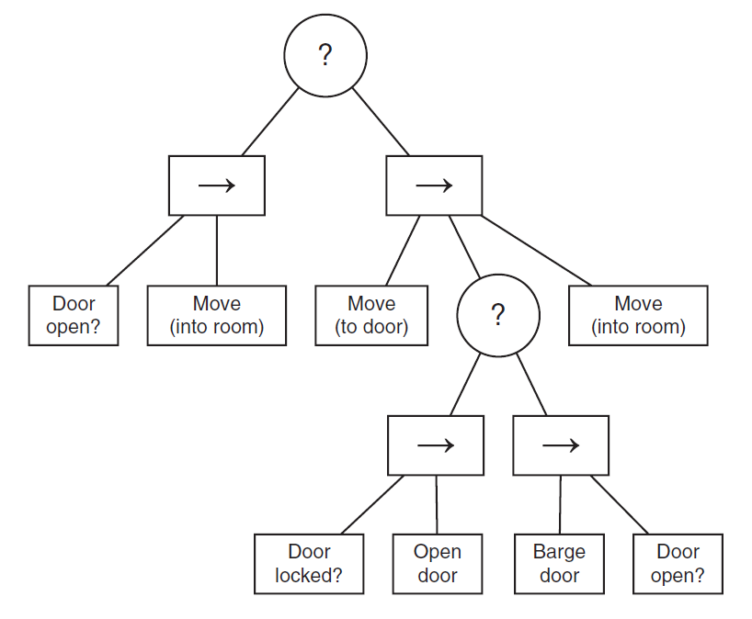
More complex Tree
Behaviour Tree for going through doors

Slide 17
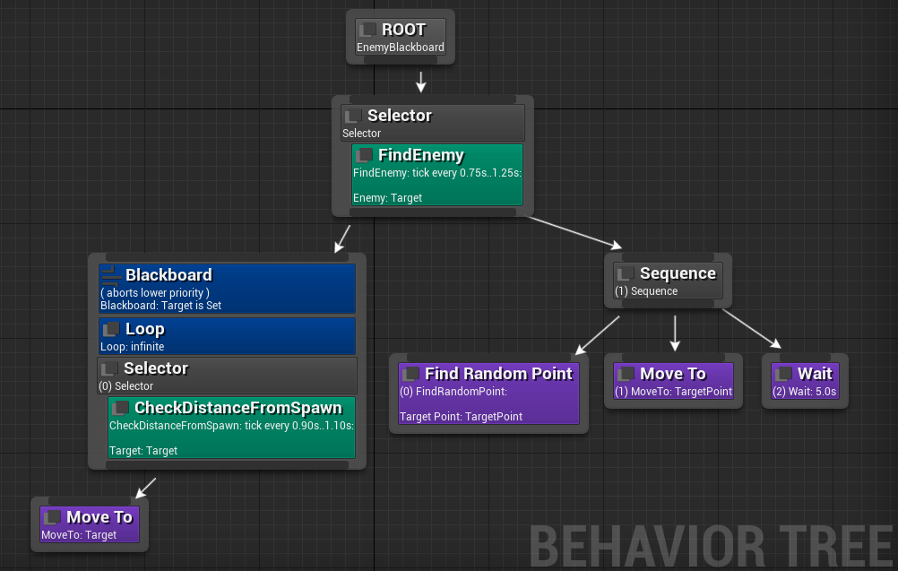
Example In Unreal 4

Slide 18
Pros And Cons
Very expressive
Complex behaviours easily developed
With GUI, can be designed by non-programmers
Can perform simple planning
If a task fails, can try alternatives
Complex sequences of actions possible
Can have performance issues
Traverse entire tree every frame
If tree is large, can be slow
Can be problematic when AI needs to respond to external events

